Slide 1

Understanding Scrum-Agile Development: SNHU Travel Case Study
Presented by: Moe Holder
Scrum Master at ChadaTech
February 2026

Slide 2



Explaining Agile Roles
WHY ROLES MATTER: Clear role definition prevents confusion, ensures accountability, and enables autonomous decision-making within appropriate boundaries (Schwaber & Sutherland, 2020).
Product Owner
Engages and represents stakeholders, defines acceptance criteria for user stories, manages backlog prioritization, and ensures project alignment with business goals while delivering maximum value.
Scrum Master
Facilitates Scrum events, removes impediments blocking team progress, coaches team on Agile principles and fosters team collaboration. Protects from external interruption and drives continuous improvement.
Development Team
Self-organizing cross-functional team made up of developers, testers, designers responsible for delivering a working each sprint. Their collaboration ensures timely delivery and product quality.

Slide 3

Explaining Agile Phase
WHY IT MATTERS: Unlike waterfall's sequential phases, Scrum operates in time-boxed sprints that repeat cyclically, with each sprint producing a potentially releasable increment and opportunities for inspection and adaptation (Schwaber & Sutherland, 2020).
01
PROJECT INCEPTION
Define vision, goals, and feasibility. Establish initial requirements and business case. Form the team, Sprint length is decided.
02
SPRINT PLANNING
Beginning of each sprint (2-4 weeks)
Select backlog items, define sprint goal, commit to deliverables
03
DAILY STAND-UP
15 minutes daily
What I did yesterday, what I'll do today, any blockers
04
DEVELOPMENT & TESTING
Throughout sprint, coding, testing, integration, refinement. Release and prepare for deployment, finalize documentation, and deliver the product to users. In production maintain and support the live product. Monitor performance and address issues.
05
SPRINT REVIEW
End of sprint (2-4 hours)
Demonstrate working software to stakeholders, gather feedback
06
SPRINT RETROSPECTIVE
After Sprint Review (1-2 hours)
Reflect on process, identify improvements and act on improvements listed before next sprint.

Slide 4
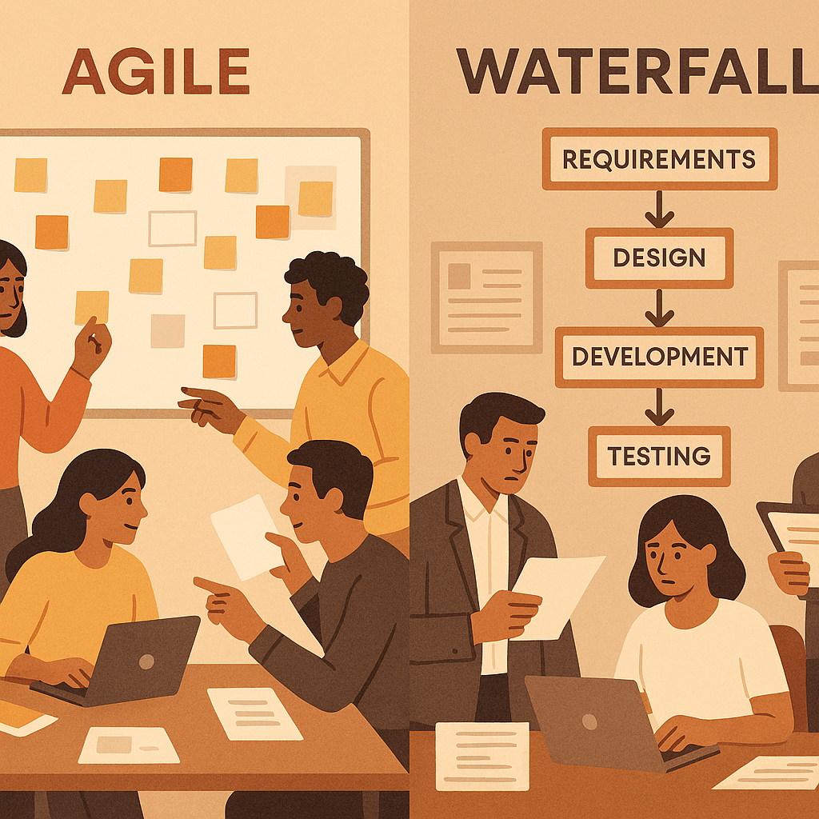
Describing Waterfall Model
WHY IT MATTERS: Scrum's iterative, incremental approach enables rapid adaptation to market changes, contrasting sharply with waterfall's sequential phases that resist mid-project course corrections (Schwaber & Sutherland, 2020).
WATERFALL APPROCH:
Requirements Phase:
All requirements defined upfront during intake meeting
A detailed time extensive specification document is created
Requires sign-off before proceeding
Change Happens: Requires formal change request and can impact development from weeks to months
Design Phase:
Complete design based on original requirements
Detailed wireframes
Change Happens: Existing design documents are now invalid and now the team has to get re-approval and do “rework”
Development Phase:
Application system built from specification
Change Happens: Code rework is required and this will be costly and cause delays
Testing Phase:
Test against original requirements
Change Happens: Existing test plans invalid re-testing needed
WATERFALL APPLIED SNHU TRAVEL CASE:
Original Requirement:
Scrollable list view showing all 5 destinations simultaneously
Stakeholder Feedback:
We would like to display destinations one at a time, like a slideshow?
Steps to facilitate change:
Formal change request documentation
Update analysis on existing design
Updated UI/UX specifications
Architecture review required and approval
Re-estimation of development effort
Schedule and budget revision
Stakeholder sign-off on changes
Implementation of approved changes
Updated test plans and re-testing
Timeline 4-12 weeks
TAKEAWAYS:
In waterfall, this change may take 4-12 weeks and required a lot of “rework”. Due to the bureaucracy of formal change requests, required approval, updating requirements, specifications, design revisions etc.

Slide 5
Waterfall or Agile Approach
CHOOSE WATERFALL APPROACH IF:
Requirements are fixed and well-understood
Stakeholders cannot provide ongoing feedback
Project has marginal uncertainty
Change is detrimental to the company goals
Team has no time for training and no Agile previous experience
CHOOSE AGILE APPROACH IF:
Requirements change based on market feedback and competitive advantage
Stakeholders available for regular collaboration and feedback
Experimentation is welcomed
Customer needs are or not fully understood
User experience is critical to success
SNHU TRAVEL CASE
SELECTED AGILE APPROACH:
Travel industry is volatile and trends change quickly (Example: wellness pivot)
Stakeholders provided continuous feedback (Example: Intake and Sprint Review)
New requirements develop from application demonstration and stakeholders feedback (Example: Adapted code and test cases)
Having a working product for user experience (Example: slideshow change)

Slide 6
References
Popa, D. (2023). Agile Management and Leadership in Education. EIRP Proceedings, 18(1), 451–457.
Layton, M. C. (2023). Scrum / Mark C. Layton (Third edition.). John Wiley & Sons, Inc.
Fawareh, H., Al-Smadi, Y., Saadeh, R., Fawareh, F. A., Elrashidi, A., & Al-Shdaifat, H. M. (2024). A Comparative Study between Agile and Waterfall Methodologies during Software Development Process. 2024 25th International Arab Conference on Information Technology (ACIT), Information Technology (ACIT), 2024 25th International Arab Conference On, 1–5. https://doi.org/10.1109/ACIT62805.2024.10877239
Schwaber, K., & Sutherland, J. (2020). The Scrum guide: The definitive guide to Scrum: The rules of the game. Scrum.org. https://scrumguides.org/
Cobb, C. G. (2015). The project manager's guide to mastering Agile: Principles and practices for an adaptive approach. Wiley.
Highsmith, J. (2009). Agile project management: Creating innovative products (2nd ed.). Addison-Wesley Professional.
Beck, K., Beedle, M., van Bennekum, A., Cockburn, A., Cunningham, W., Fowler, M., Grenning, J., Highsmith, J., Hunt, A., Jeffries, R., Kern, J., Marick, B., Martin, R. C., Mellor, S., Schwaber, K., Sutherland, J., & Thomas, D. (2001). Manifesto for agile software development. Agile Alliance. https://agilemanifesto.org/

